Slide 1
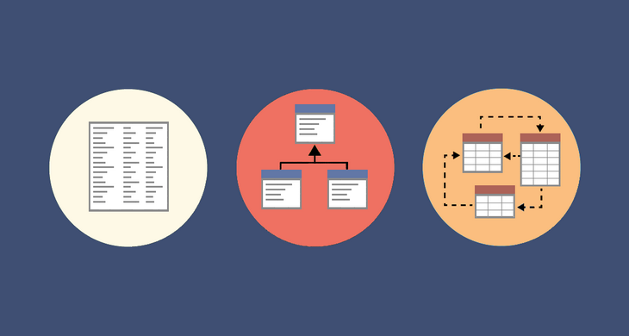
Warehouse and analytical build
Practical

Slide 2
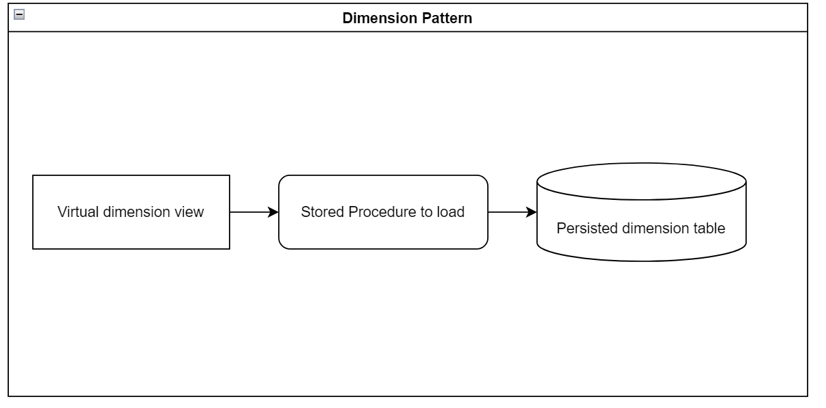
Dimensions
Dimensions can be type 1 or type 2. Follow the direction for the requested dimension.
Only the date dimension which is type 1 should be built with a truncate and insert.
Each Dimension should be built using the following method.

Slide 3
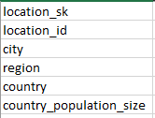
The Requirements 1 – Geography Dimension
The client wants a Geographic dimension.
This dimension needs to be persisted and should be built as a type 1 dimension i.e. no need to track history.
The dimension should consist of the following columns.

Slide 4
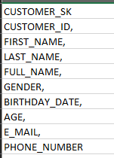
The Requirements 2 – Customer Dimension
The client wants a customer dimension.
This dimension needs to be persisted and track history changes over time, so it should be built as a type 2 dimension.
The dimension should consist of the following columns. But also include change tracking columns.
Your load should cater for a ghost record, for this use the -1 sk and -1 code.

Slide 5
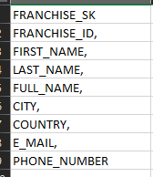
The Requirements 3 – Franchise Dimension
The client wants a Franchise dimension.
This dimension needs to be persisted and should be built as a type 1 dimension i.e. no need to track history.
The dimension should consist of the following columns.

Slide 6

The Requirements 4 – Menu Type
The client wants a Menu Type dimension.
This dimension needs to be persisted and should be built as a type 1 dimension i.e. no need to track history.
The dimension should consist of the following columns.

Slide 7
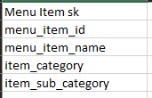
The Requirements 5 – Menu Item
The client wants a Menu Item dimension.
This dimension needs to be persisted and should be built as a type 1 dimension i.e. no need to track history.
The dimension should consist of the following columns.

Slide 8
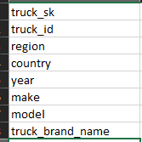
The Requirements 6 – Truck
The client wants a truck dimension.
This dimension needs to be persisted and should be built as a type 1 dimension i.e. no need to track history.
The dimension should consist of the following columns.

Slide 9

The Requirements 7 – Currency
The client wants a currency dimension.
This dimension needs to be persisted and should be built as a type 1 dimension i.e. no need to track history.
The dimension should consist of the following columns.

Slide 10
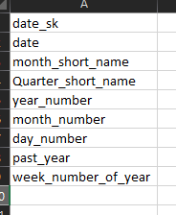
The Requirements 8 – Date
The client wants a date dimension.
This dimension should be a type 1, so no need to track history.
The dimension should consist of the following columns.
For the date dimension you can use a truncate and insert because the sk will be the date as an integer (date_id)

Slide 11
The Requirements 9 – Validation
Write validation scripts for the customer dimension and the truck dimension to compare the dimensions to source. No need to do full validation, we just want to check for completeness in terms of records (all truck id’s or customer ids from the table must be in the dim)
Write test logic to test our load procedures. For the truck type 1 dimensions, manually update a record in the dim table and then run the load and see if it updates back, this will be a simulated change.
Do the same for the customer type 2 dimension however you should see a newer record in the type 2 instead of the original being updated.

Slide 12
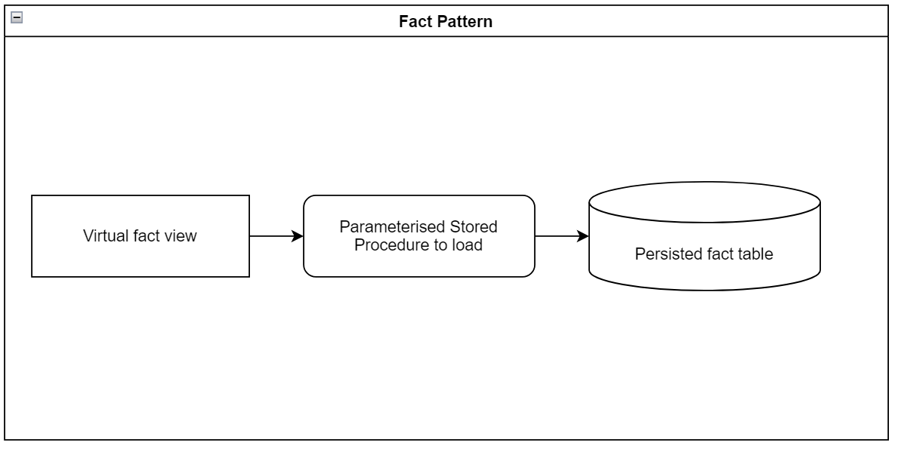
Fact Tables
The Fact table loads should include a start date and end date parameter so that the fact tables can be loaded for a date range.
Fact tables should fit this pattern.

Slide 13
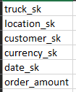
The Requirements 10 – Aggregated Fact Tables
Create an aggregated fact table that contains high level orders.
Just a reminder that the customer key is not populated for all records and customer is a type 2 dimension.
Your fact table should contain the following columns.

Slide 14
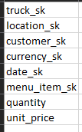
The Requirements 11 – Detailed Fact Tables
Create an detail fact table that contains all the order details.
Just a reminder that the customer key is not populated for all records and customer is a type 2 dimension.
Your fact table should contain the following columns.

Slide 15
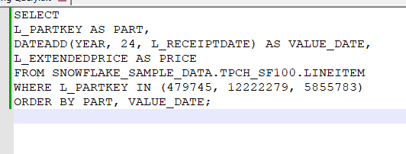
Extra time task– Timeseries
If we have time after we are done with the requirements thus far, this is an extra task to teach some useful skills.
Sometimes we may need to create data to fill out gaps when the client wants to look at things in a timeseries fashion. Use the Starting query below in a CTE to explode the data using the date dimension. So for each part key, we have one record per day and fill in the price for the days where we do not have a price using an analytical function. The query below will be in your pack of files.

Slide 16
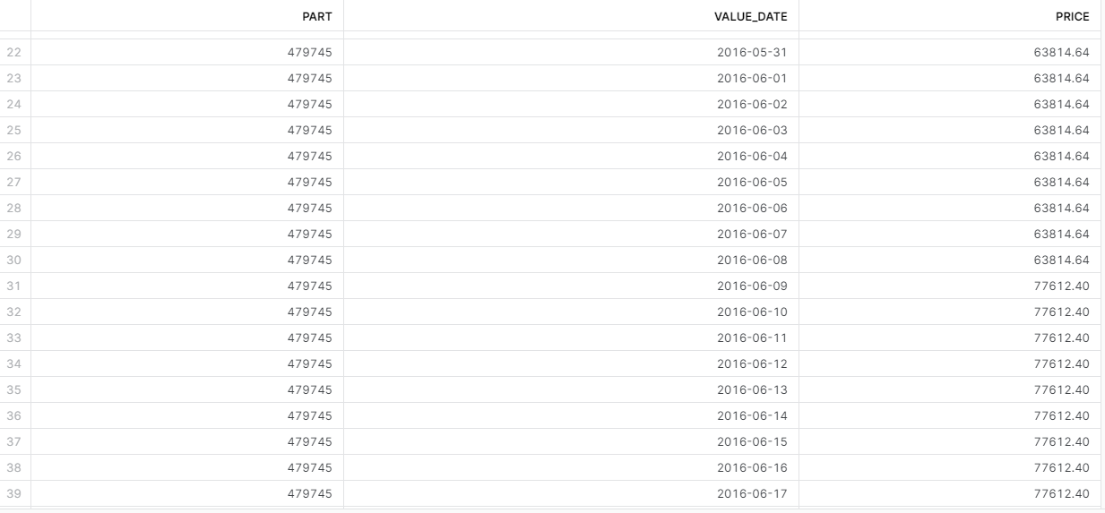
Extra time task - output
Your results should look like so

Slide 17
Questions?

